Slide 1
Chongqing University of Technology
ATAI
Advanced Technique of Artificial Intelligence
Chongqing University of Technology
Dependency Graph Enhanced Dual-transformer Structure for Aspect-based Sentiment Classification
(ACL-2020)
Reported by Ling Zhu
Code:https://github.com/tomsonsgs/DGEDT-senti-master

Slide 2
Chongqing University of Technology
ATAI
Advanced Technique of Artificial Intelligence
Chongqing University of Technology
1. Introduction
2. Motivation
3. Approach
4. Experiments
5. Conclusion

Slide 3
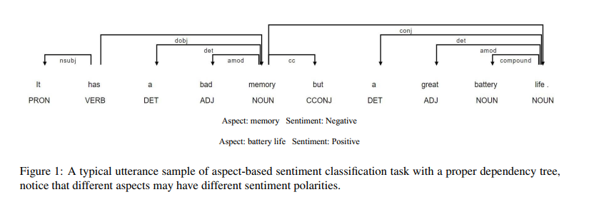
Introduction

Slide 4
Introduction
Current issues:
the noisy information is inevitably introduced through the dependency tree, due to imperfect parsing performance and the casualness of input sentence;
GCN would be inherently inferior in modeling long-distance or disconnected words in the dependency tree.

Slide 5
Motivation
a dependency graph enhanced dual-transformer network (named DGEDT) by jointly considering the flat representations learnt from Transformer and graph based representations learnt from the corresponding dependency graph in an iterative.

Slide 6
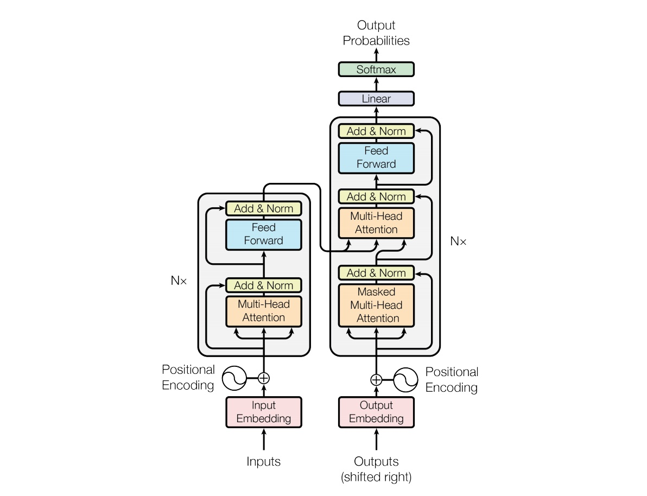
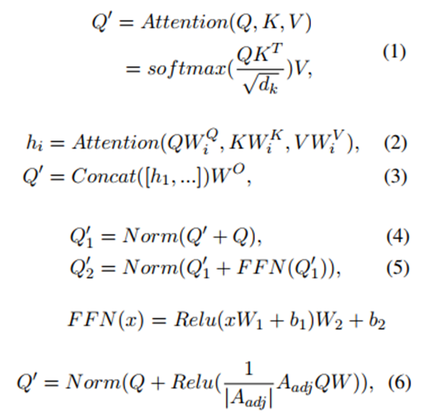
Approach

Slide 7
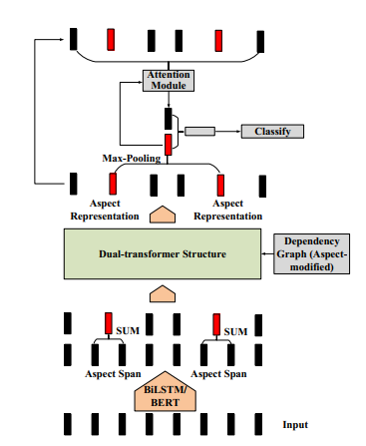
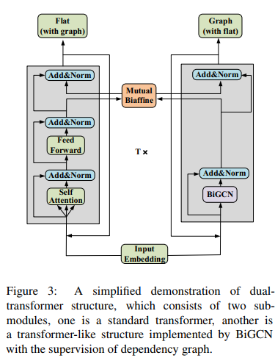
Approach
Notes:
http://chenhao.space/post/4d360cad.html#experiments
https://blog.csdn.net/qq_37262929/article/details/108602718

Slide 8
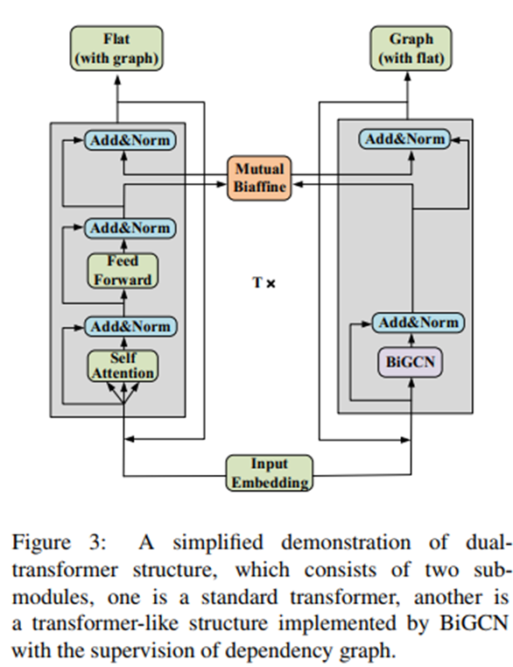
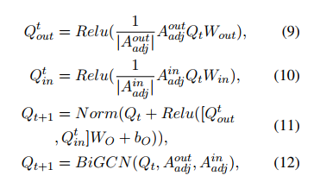
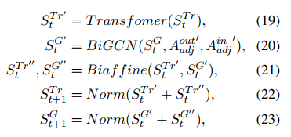
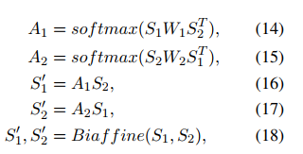
Approach
Bidirectional GCN:
BiAffine Module:

Slide 9
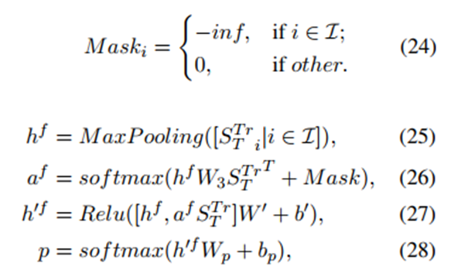
Approach
Aspect-based Attention Module

Slide 10
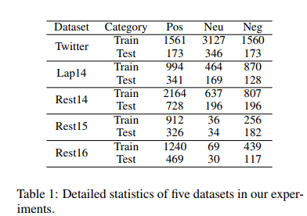
Experiments

Slide 11
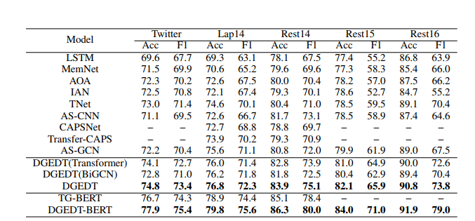
Experiments

Slide 12
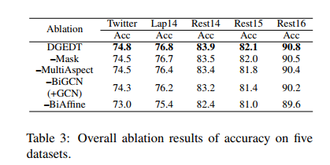
Experiments

Slide 13
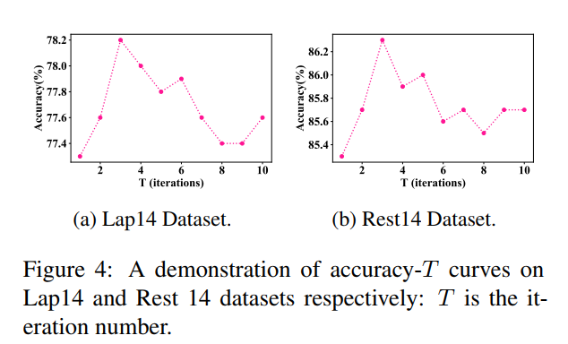
Experiments

Slide 14
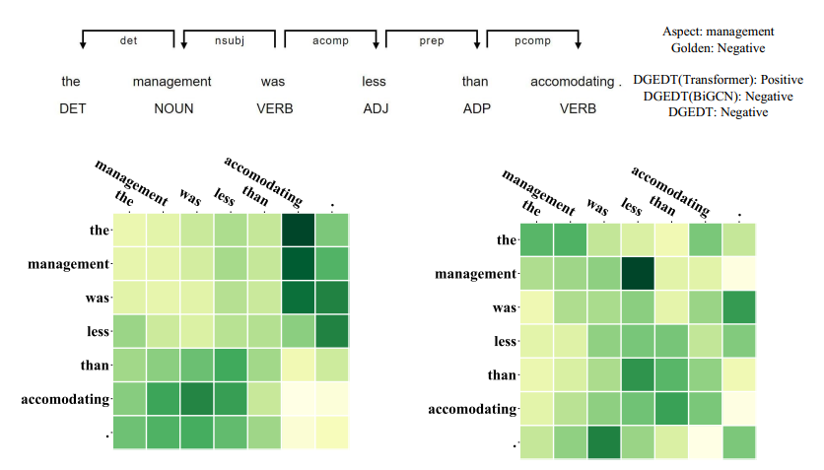
Experiments

Slide 15
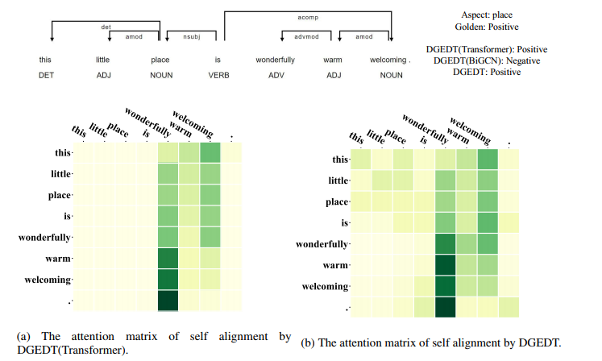
Experiments

Slide 16
Thanks

